Slide 1
Gene Editing and its Role in Dairy
Yalda Zare, PhD
ABS Global
12/13/2017

Slide 2
A bit about Genus
Improving animal genetics
Combating livestock disease through gene editing
Commercial perspective of applying gene editing in livestock

Slide 3


Genus details
UK headquartered
Historically three distinct business
Genus
UK “milk marketing board” made private by Thatcher Administration
PIC
Pig Improvement Company UK founded but US based today
ABS Global Inc
(US Based) “AI company”

Slide 4
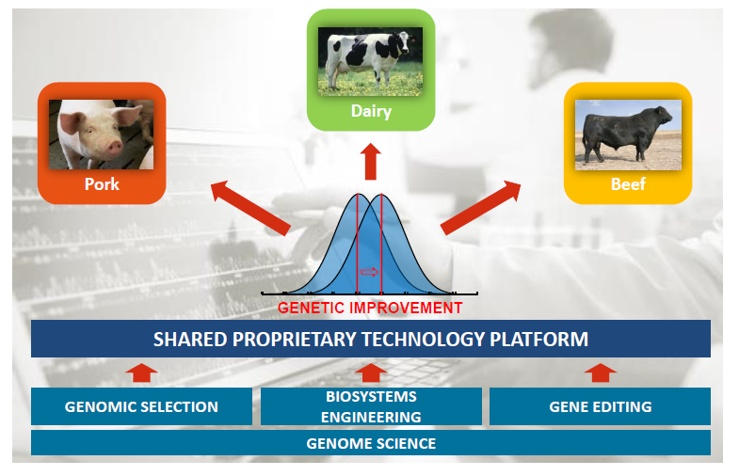
Genus Products and Technology Platform

Slide 5

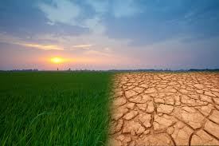
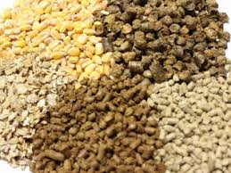
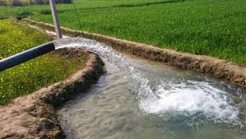
Feeding the World
10 billion people by 2050
70% increase in food production
Climate change
Shortage of resources
Notes:
World’s population is predicted to reach 10 billion people by 2050
With shortage of resources, climate change and increased demand of nutrition we can’t feed the world with the current agricultural systems
New methods of increasing the production of agricultural products, crops and animals with minimal impact on environment is essential

Slide 6
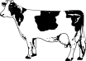
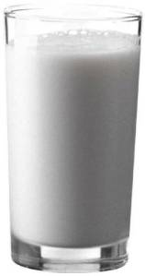
Improved milk production
60% fewer cows
60% more milk
1944
2009
USDA, Innovation Center for US Dairy

Slide 7
Advances in animal breeding
Advances in genotyping and sequencing of genomes
Development and application of genomic selection (the most important breakthrough since BLUP in 1940s)
Since 2009 genomics has dramatically changed dairy cattle breeding
Genomic research is ongoing
Detect causative genetic variants
Find more haplotypes that affect fertility
Improve accuracy and reduce bias

Slide 8
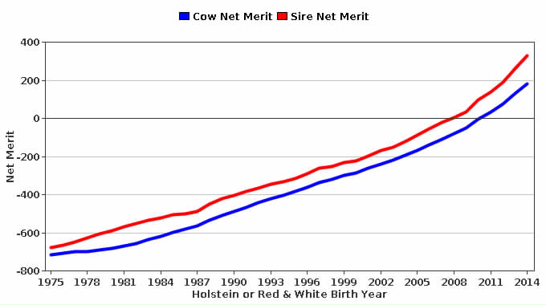
Progress/Genetic Trend in U.S. Holsteins
For cows born in 1990 to 2009, the average genetic progress in U.S. Holsteins was $23 Net Merit (NM) per year
Since genomics, cows born since 2009, the average genetic progress has been $46 NM per year – twice the progress!
The progress is driven by the high merit of the sires
reference https://www.uscdcb.com/eval/summary/trend.cfm?R_Menu=HO.nm#StartBody

Slide 9
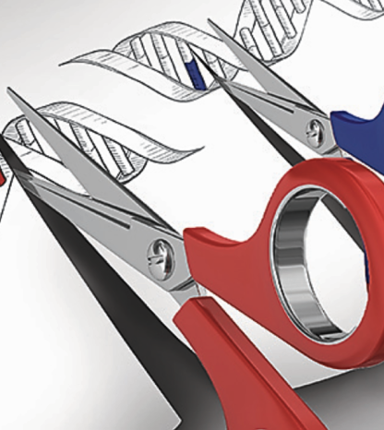
We need new methods of increasing agricultural products, crops and animals with minimal impact on environment
The idea of editing genomes has been around since 1970s. Last few years, several important advances in editing techniques occurred.

Slide 10
Transgenesis vs. genome editing
Transgenesis: Introducing an exogenous gene -called a transgene - into a living organism so that the organism will exhibit a new property and transmit that property to its offspring.
Genome editing: DNA is inserted, deleted or replaced in the genome of an organism using engineered nucleases, or "molecular scissors."
Notes:
A transgenic animal is one whose genome has been changed to carry genes from other species.

Slide 11
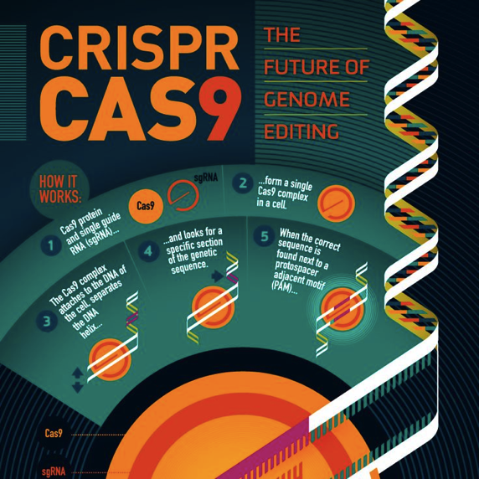

Genome editing nucleases:
ZFN (Zinc finger nucleases)
TALEN (transcription activator-like effector nucleases)
CRISPR (clustered regularly interspaced short palindromic repeats)
The difference in these techniques is the way they recognize a target location and efficiency
ZFN and TALEN use DNA-protein binding sites, (complex and costly)
CRISPR uses RNA (simpler, more popular
and more efficient)

Slide 12
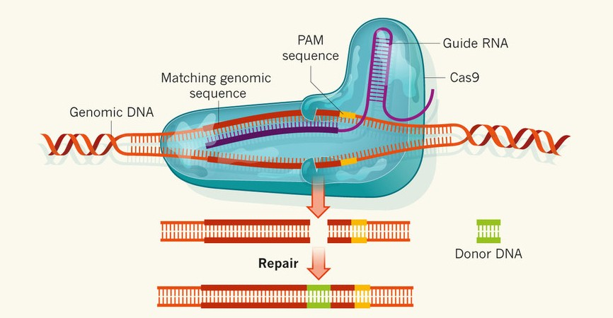
Gene editing to improve health: CRISPR Cas9
Step 1: Create a genetic sequence, called, guide RNA, that matches the piece of DNA to be edited
Step 2: Add guide RNA to a cell along with Cas9 enzyme, which will act like a pair of scissors that cuts DNA
Step 3: The guide RNA binds to the target DNA sequence and Cas9 makes a cut in the target DNA
Step 4: Desired DNA edits are made and cell enzymes repair the cuts
CRISPR-Cas9 enables deletions and/or addition to the target DNA; Genus-PIC focuses on deletions only so no foreign DNA is introduced to the target DNA

Slide 13
Gene Editing in Agriculture
Opportunity
New technologies allow rapid hypothesis testing
Promising proof of concept results in livestock
Genuine market needs
Editing as opposed to transgenesis
Challenge
Livestock genetics continuously improves
Biology of reproduction creates one set of constraints
Novelty of technology means regulatory framework is evolving rapidly
Public acceptance is not a given

Slide 14
Genus Approach
Technology choices emphasizing
Real farmer economic benefit
Genuine animal well being benefits
Science supported sustainability benefits
Developing technology transparently and responsibly
Meeting markets where they are in terms of technology acceptance
Proactively engaging regulators and stakeholders

Slide 15
Two Technology Examples: Porcine & Bovine
Porcine:
PRRSv resistance mediated by CD163 loss of function edits
Current Status: Phase 2- Early Development
Farmer benefit clear
Animal health benefit established
Bovine:
Bovine Respiratory Disease (BRD) resilience mediated by CD18 domain deletion
Current Status: Phase 1- Proof of concept
Potential Farmer benefit
Potential animal health benefit

Slide 16
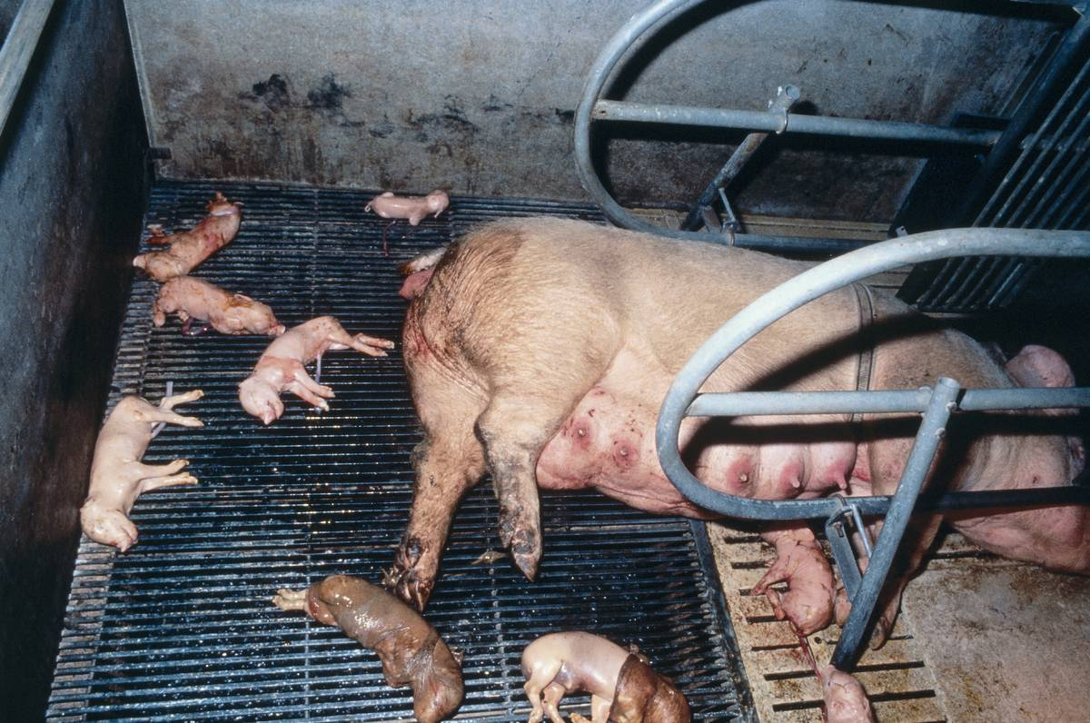

Gene-edited Porcine
Porcine Reproductive and Respiratory Syndrome (PRRS) the most economically important disease of swine (>$600 M per year in North America)
CD163 suggested as receptor for entry of PRRSV into cells.
Pigs lacking functional CD163 (edited using CRISPR-cas9) are resistant to PRRSV.
Whitworth et al,
nature biotechnology 2016

Slide 17
Notes:
7 wildtype and 3 null piglets
% of piglets with Respiratory signs at various days after the challenge
Cd163-/- displayed no signs of resoiratory or fever
Viremia (viral RNA) appeared at day 4 reached to peak at day 11 then declined
Viral RNA was not detected in null type
The antibody response was measured weakly to day 28, plateau on day 14 in positive type
No response in the null type at any point of study

Slide 18
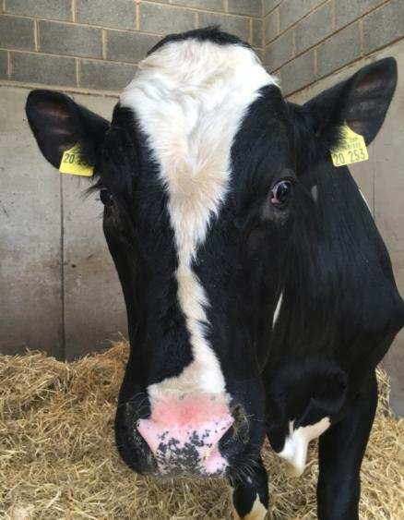
Bovine Example: “Shipping Fever”/ BRD
Bovine Respiratory Disease Complex (BRD)
Multifactorial respiratory disease
Predisposing factors include
Stress
Viral pathogens (eg BHV1, BVDV)
Mannheimia Haemolytica
Most important pathogen in BRD
Causes severe pneumonia
Costs US cattle industry ~$1 billion per year
Mortality & morbidity losses
Dairy and beef cattle affected

Slide 19
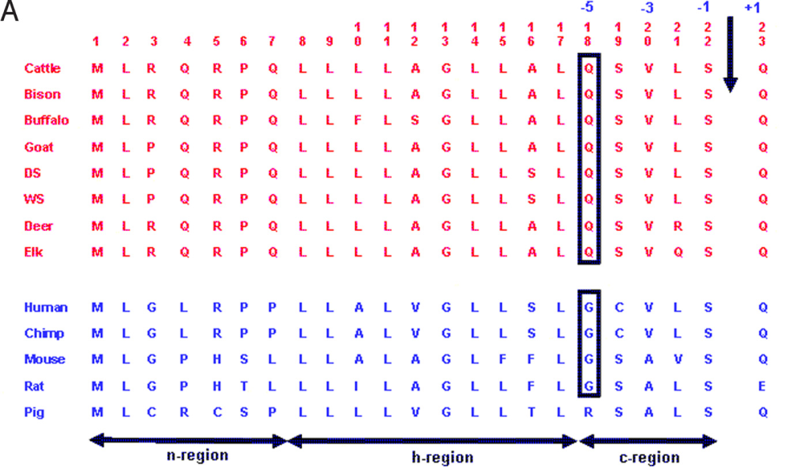
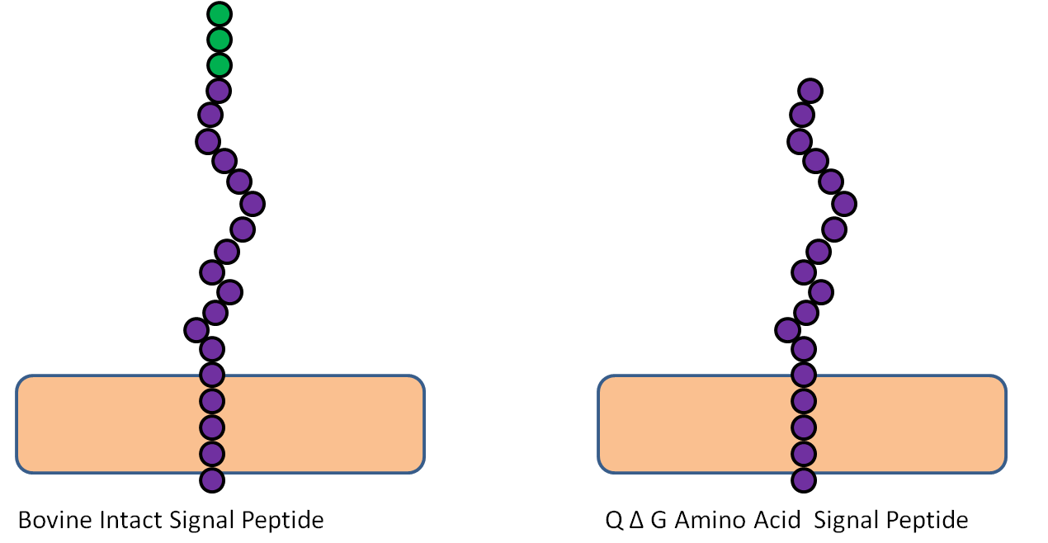
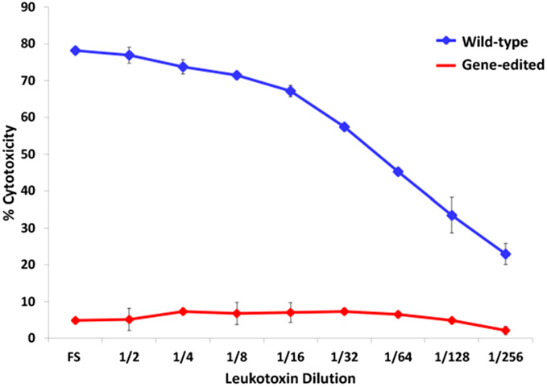
Main virulence factor is the production of leukotoxin, which kills host white blood cells, which in turn causes acute inflammation and lung pathology.
CD18 suspected target for leukotoxin
B
In vivo
leukotoxin resistance
Shanthalingham, PNAS, 2016

Slide 20
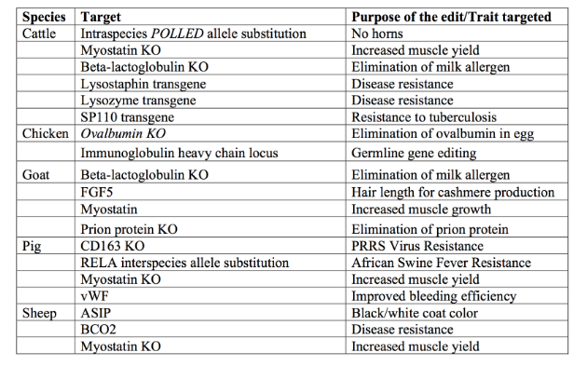
Examples of gene edited agricultural applications in food animal species
KO = knock out or inactivation of gene function.
Reproduced and modified from Van Eenennaam AL. 2017.
Genetic modification of food animals. Curr Opin Biotechnol 44:27-34.

Slide 21
Editing for commercial production
Select breeding lines for editing
Sequence analysis
Introduce simple, precise, reproducible sequence changes
Trait evaluation of edited animals-maintain genetic merit
Disease resistance
Commercial performance
Meat quality and composition
Growth characteristics

Slide 22
Challenges (within our business)
Biology:
- Gestation time and generation interval put compelling animal challenge trials off by years
System:
- Core customer expectations and needs
- Multiple breed requirements
- Extreme delta G expectations in temperate dairy breeds render founders >2-3 years behind the leading edge of marginal economic prospects
- Necessity of homozygotes to deliver value in heterogeneous genetic system.

Slide 23
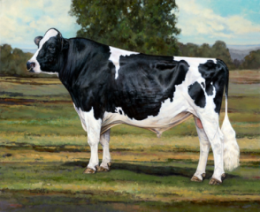
Dairy Animal Timeline - Example
Calf
born
Males Homozygous,
Mating Age
Puberty
& Matings to Edited
Females
Offspring
born
Gene Edit & Conception
Generation 1
Creation of Edited Founder Sires & Dams (Most Heterozygous),
Likely little selection pressure on genomics
Due to pop. size
Genomics
Genomics
-9mo.
0 mo.
14-15 mo.
33 mo.
48 mo.
Review Success of Edit
Roughly lag of about $150 NM behind as a min.!
Targets should justify the give up on genetic gain on other economically important traits!
Generation 2
Creation of Homozygous Males to Market

Slide 24
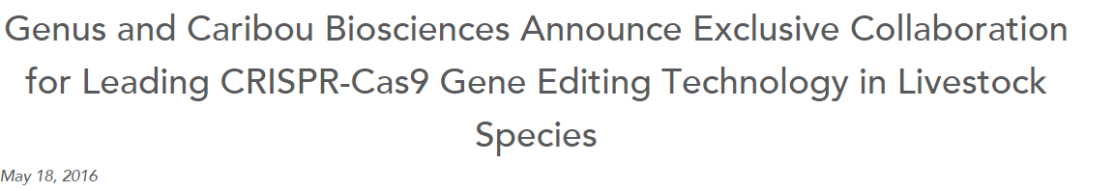
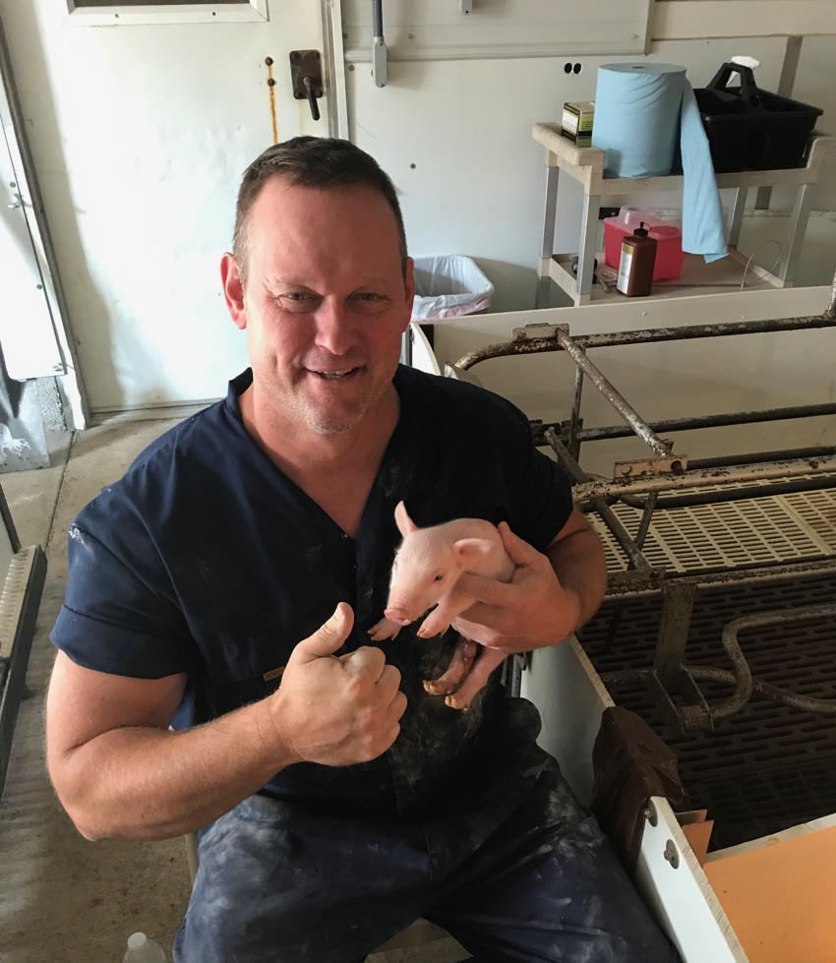



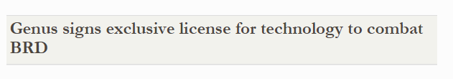
Genus – External collaborations
May 18, 2016
RenOVAte Bio
Dr. Bhanu P. Telugu, CEO
July 28, 2016

Slide 25
Application issues
Regulations and policies
Social acceptance
Health effects
Environmental effects
Moral concerns
Social effects

Slide 26
Summary
Gene editing is a tool for Ag-accelerated breeding
Genome-edited livestock differ from GM animals as no recombinant DNA is integrated into the animal genome.
New technology advances have made gene edited animals much easier to create and there are numerous examples
Opportunity
Farmer benefits
Animal benefits
System benefits
Challenges
Inherent biology of system
Genetic gain > Genetic lag
Maximize benefit by deploying into the most advanced germplasm
Regulatory issues must be resolved first before being able to market any gene-edited animals.

